Slide 1
Quantum Computing Weather Forecasting
Team #5 weather forecasting
Sherifa Helmy
Rana Saad
Youssef Ahmed
Jana ElHebishy

Slide 2
Table of contents
01
02
03
04
05
06
Problem Overview
Data Preprocessing
Classical Model
Multiple Linear Regression
Quantum Model
Challenges & Solutions
Results
QML

Slide 3
01
Overview

Slide 4
-The challenge focuses on utilizing quantum computing to enhance weather forecasting accuracy in Egypt, specifically in Cairo.
-Weather forecasting is considered a challenge due to the chaotic nature of atmospheric systems, requiring significant computational power to process large datasets and patterns.
-Traditional forecasting methods often struggle with the intensity and precision on the long-term predictions. On the other hand, quantum computing handles complex optimization, pattern recognition, and probabilistic modeling, improving the accuracy and efficiency of weather predictions.
Our goal is: to utilize quantum algorithms in analyzing weather data, based on temperature, precipitation, or wind speed. So we can develop a quantum model which identifies patterns, optimizes forecasting algorithms, and reduce computational time compared to classical methods.

Slide 5
02
Data Preprocessing

Slide 6
Processing
Data
Loading the data
Exploring data
Handling missing values
Removing identical columns
Fixing data types
Saving cleaned data

Slide 7
03
Classical Model
Multiple Linear Regression

Slide 8
Multiple Linear Regression
Is a ML method used to model the relationship between one dependent variable (target) and two or more independent variables (features).
It's an extension of simple linear regression, which only involves one independent variable.
MLR tries to minimize the squared errors between actual and predicted values.

Slide 9
WHY Multiple Linear Regression?
Multiple Features → Matches our dataset structure — we use several weather variables like rain, wind, humidity, and sunshine.
Numerical Inputs → All features are continuous values, which is ideal for regression models.
Single Output→ We are predicting only one continuous target: temperature,.
Performs Well on Large Datasets→ Efficient, fast to train, and scalable to thousands of records

Slide 10
04
Quantum Model
Quantum Machine Learning

Slide 11
Quantum Machine Learning
Developed a hybrid quantum–classical regression model using Quantum Neural Network (QNN) to predict Cairo’s average temperature using two features:
apparent_temperature_mean (°C)
et0_fao_evapotranspiration (mm)

Slide 12
Quantum Architecture:
Feature Map: ZZFeatureMap (1 repetition)
Ansatz: EfficientSU2 with circular entanglement
Simulator: Local backend via Qiskit Estimator
QNN Type: EstimatorQNN integrated with PyTorch
Training Setup:
Training Sample: 365 data points
Loss Function: HuberLoss
Optimizer: AdamW with StepLR learning rate scheduler
Early stopping enabled after 20 stagnant epochs
Preprocessing: MinMax scaling to range [-1, 1]

Slide 13
Insights
Observations:
High predictive accuracy using only two features
Strong correlation between predicted and actual values
Quantum modeling demonstrated effectiveness even
with limited data.
Visual graph representations that confirm prediction reliability
Future Direction:
Potential improvements with an additional complementary feature

Slide 14
05
Challenges & Solutions

Slide 15
Challenge | Solution
Long Quantum Simulation Time: Simulating quantum circuits on classical hardware is computationally expensive and time-consuming. | We selected the two most important features to reduce input dimensionality.
Training Quantum Models: The quantum model training was unstable and sometimes got stuck in local minima. | We used AdamW optimizer with Huber Loss and a learning rate schedule to help the model learn smoothly.

Slide 16
06
Results

Slide 17
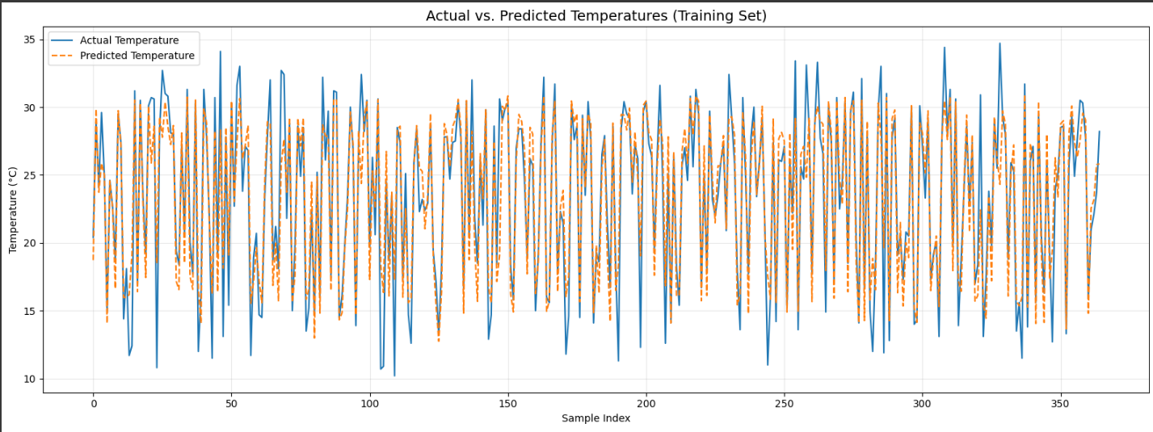
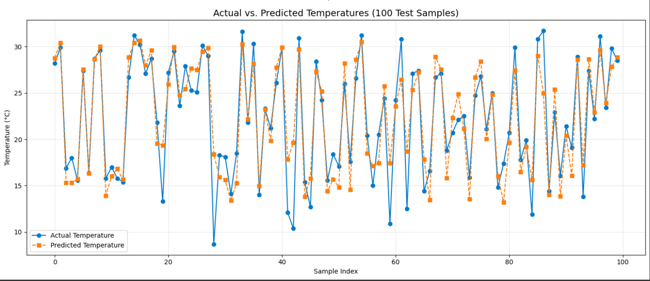
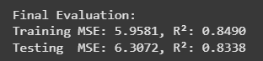
Training
Vs.
Testing

Slide 18
Classical Model | Quantum Model
Multiple Linear Regression | Quantum Neural Network (QNN) via EstimatorQNN
📉 Mean Squared Error (MSE): 0.073 📈 R² Score: 0.998 | 📉Mean Squared Error (MSE): 6.2681 📏 RMSE: 2.5036 📈 R² score: 0.8348

Slide 19
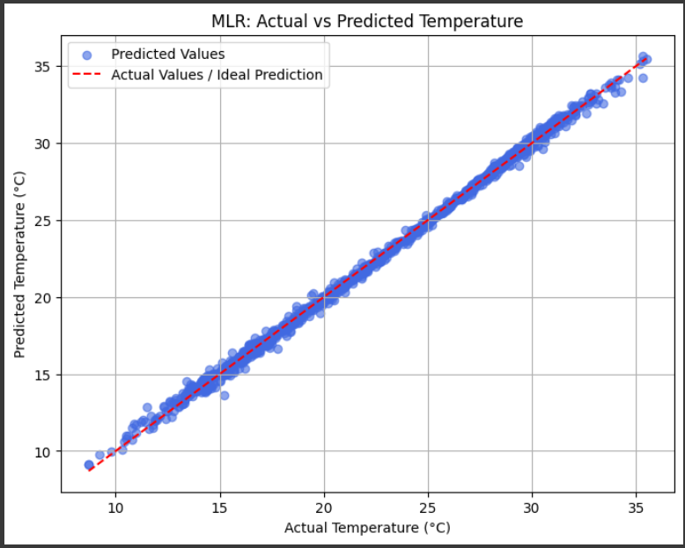
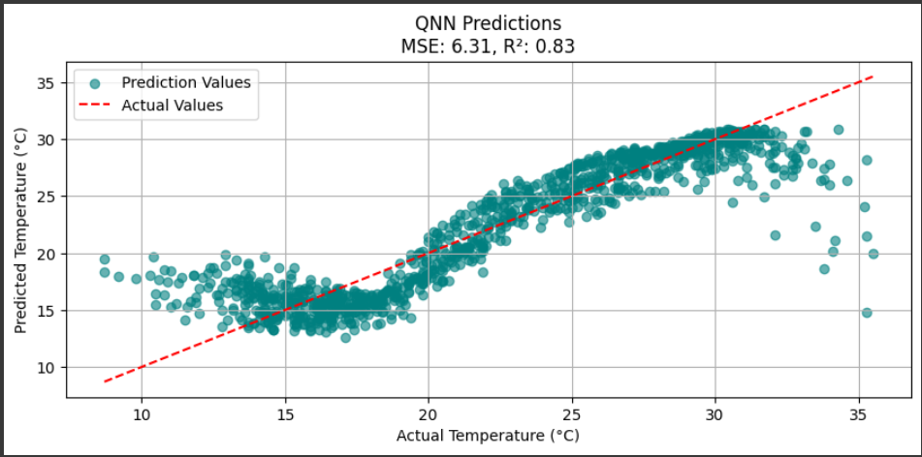
Classical Vs. Quantum

Slide 20
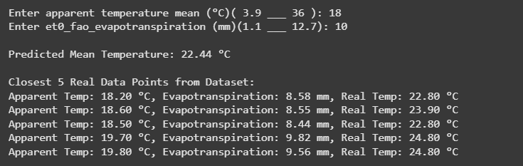
Results
While classical model currently outperform in absolute metrics,The quantum model demonstrated promising results, especially in reducing overfitting and achieving competitive accuracy with fewer trainable parameters.
Notes:
Imagine trying to predict a house's price (dependent variable) based on its size (in square feet), number of bedrooms, and location (independent variables). Multiple linear regression could help determine how much each factor contributes to the overall price.

Slide 21
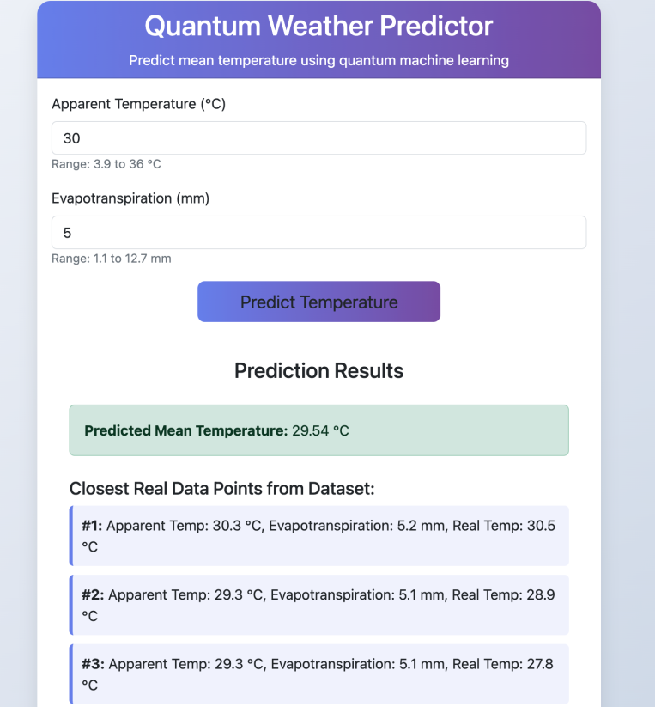
Notes:
Imagine trying to predict a house's price (dependent variable) based on its size (in square feet), number of bedrooms, and location (independent variables). Multiple linear regression could help determine how much each factor contributes to the overall price.

Slide 22
Thank you!

